Slide 1

Bank Loan Analytics
Presented by Group6

Slide 2


Introduction
KPI’s:
KPI-1: Year wise loan amount Stats
KPI-2: Grade and sub grade wise revol_bal
KPI-3: Total Payment for Verified Status Vs Total Payment for Non Verified Status
KPI-4: State wise and month wise loan status
KPI-5: Home ownership Vs last payment date stats
Excel Dashboard
PowerBI Dashboard
Tableau Dashboard
SQL
Challenges
Conclusion
INDEX

Slide 3

Introduction
A bank loan is a form of credit that banks extend to customers, enabling them to borrow funds for various needs, from personal expenses to business ventures. These loans typically require the borrower to repay the principal amount along with interest over a set term through monthly installments. The structure, terms, and costs of a bank loan depend on the borrower’s profile, the loan purpose, and the bank’s risk assessment practices.

Slide 4





KPI’s
KPI 1
KPI 2
KPI 3
KPI 4
KPI 5
Year wise loan amount stats
Grade and sub grade wise revol_bal
Total Payment for Verified Status Vs Non Verified Status
State wise and month wise loan status
Home ownership Vs last payment date stats

Slide 5
KPI 1
Insights
Gradual Increase Leading Up to 2010: Between 2007 and 2009, the growth is more incremental, starting at 2 million in 2007 and reaching 46 million in 2009. This suggests that initial growth was steady before accelerating in 2010 and 2011.
Major Spike in 2011:
The loan amount in 2011 (261M) is more than double that of 2010 (122M). This sharp increase could indicate an aggressive growth strategy, expansion into new markets, or possibly relaxed lending criteria.
Recommendation
Analyze Loan Performance for 2010 and 2011:
To sustain this growth, analyze the repayment performance and delinquency rates of loans issued in 2010 and 2011. If default rates are high, consider tightening credit requirements or offering financial support programs for at-risk borrowers.
Explore New Markets Carefully:
If the increased loan volume is due to expansion into new geographic or market segments, evaluate the loan performance and default risk within these segments before committing to further expansion.

Slide 6
KPI 2
Insights
High Revolving Balances in Grades A, B, and C:
The highest revolving balances are concentrated in grades A, B, and C, particularly in sub-grades A4, A5, B3, B4, B5, and C1. This suggests that customers in these sub-grades maintain higher amounts of outstanding debt, which could either indicate higher credit usage or greater credit limits granted to these lower-risk segments.
Recommendation
While revolving balances are lower in these grades (E, F, and G), the risk of default is higher due to lower creditworthiness. Offer financial education or debt management resources to customers in these grades, helping them improve their credit standing and potentially reducing delinquency rates.

Slide 7
KPI 3
Insights
Verified customers contribute to 59% of the total payments, which indicates that they make up a larger share of the bank’s payment volume.
Non-Verified customers still account for 41% of total payments, showing that this group is also a valuable segment, even though they might not meet the full verification criteria.
Recommendation
Encourage Verification Process:
The bank should encourage non-verified customers to complete the verification process. Verified customers appear to contribute more to total payments, which could imply lower risk and greater financial stability. Offering incentives like lower interest rates, quicker approval, or access to special services could motivate more customers to verify.

Slide 8
KPI 4
Insights
There is a noticeable peak in loan status counts at the end of each quarter (March, June, September, and December), with the highest peak occurring in December. This pattern suggests increased loan activity or status updates at the end of each quarter, which may be due to reporting cycles, loan disbursement strategies, or seasonal demand.
Recommendation
Analyze Reasons for Quarterly and Year-End Spikes: To understand what drives these quarterly and year-end spikes, the bank could analyze customer behavior or economic factors. This insight can help optimize loan offerings and anticipate demand more accurately.

Slide 9
KPI 5
Insights
From October to December, there is a notable increase in both Mortgage and Rent categories, possibly due to seasonal moves, year-end real estate incentives, or financial planning adjustments by households.
Recommendation
Although the “Other” category is consistently low, investigating what types of housing this includes and understanding the needs of this segment could provide opportunities to expand offerings or adjust housing policies to support a more diverse array of housing needs.

Slide 10
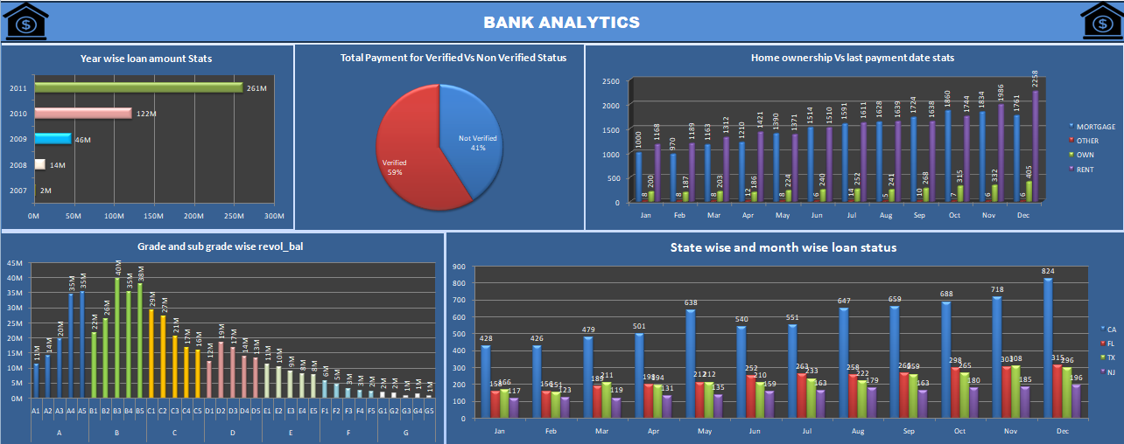
Excel Dashboard

Slide 11
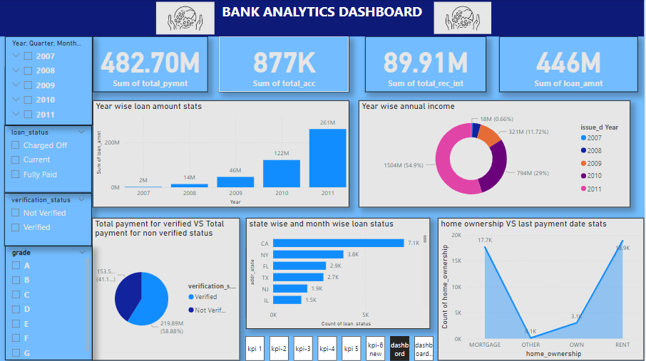
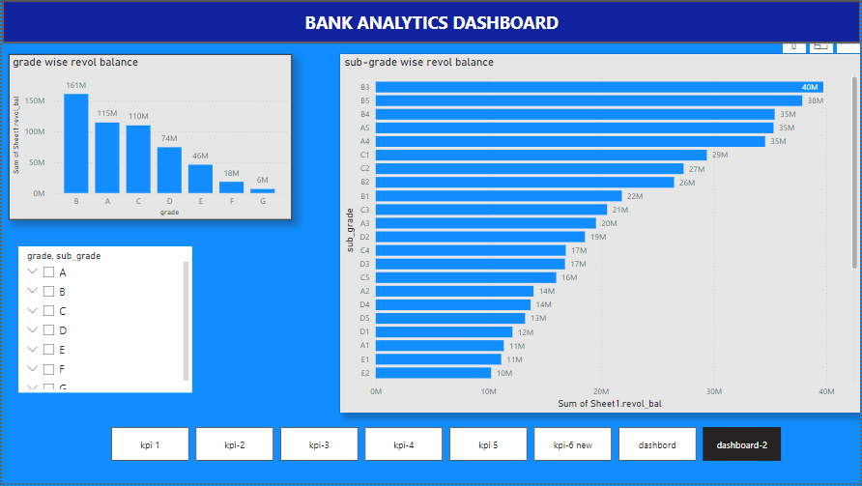
Power BI Dashboard

Slide 12
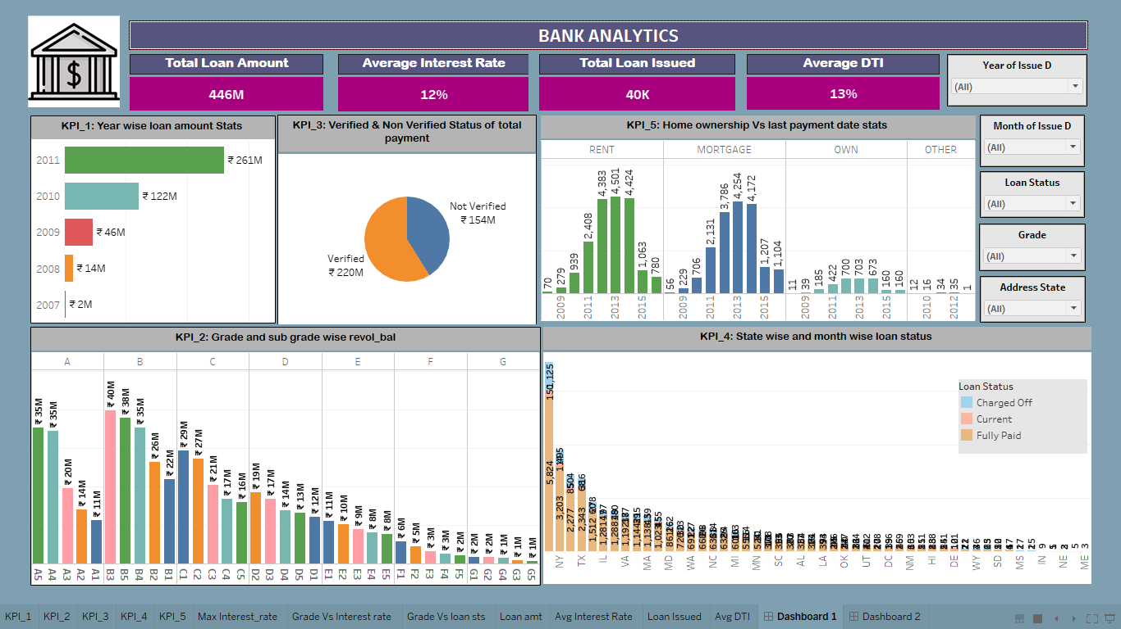
Tableau Dashboard

Slide 13
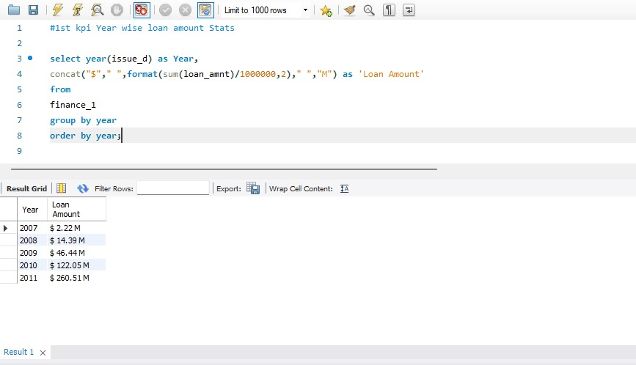
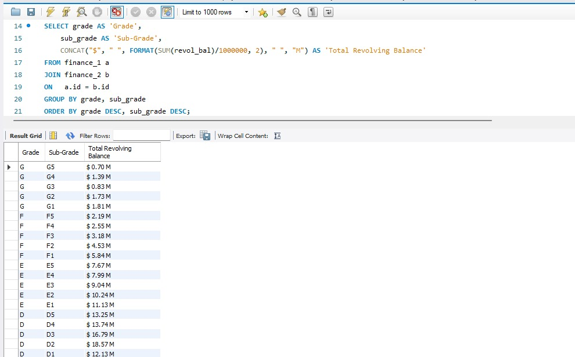
SQL
Year wise loan amount Stats
Grade and sub grade wise revol_bal

Slide 14
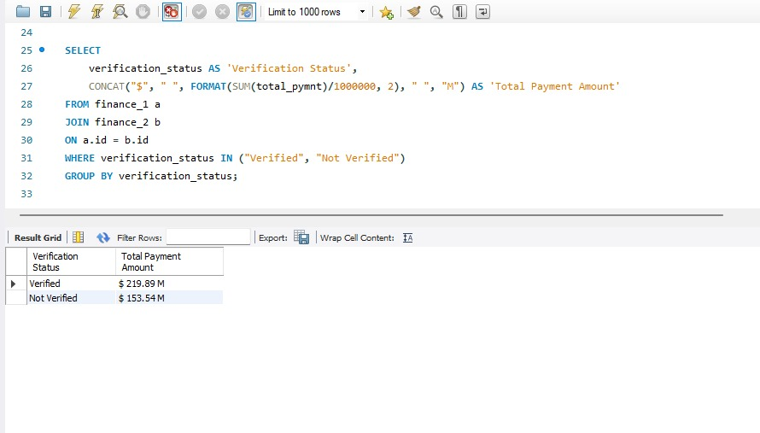
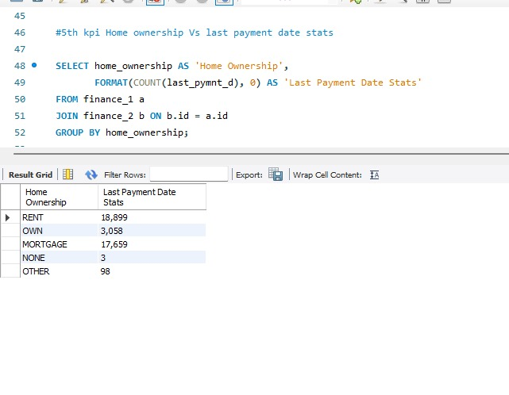
SQL
Total Payment for Verified Vs Non Verified Status
Home ownership Vs last payment date stats

Slide 15
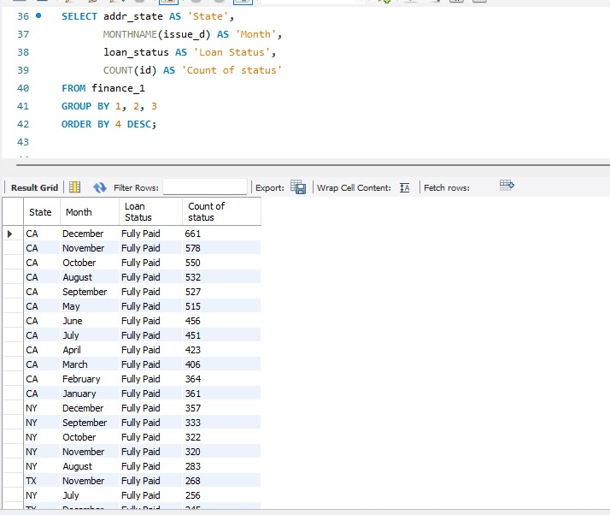
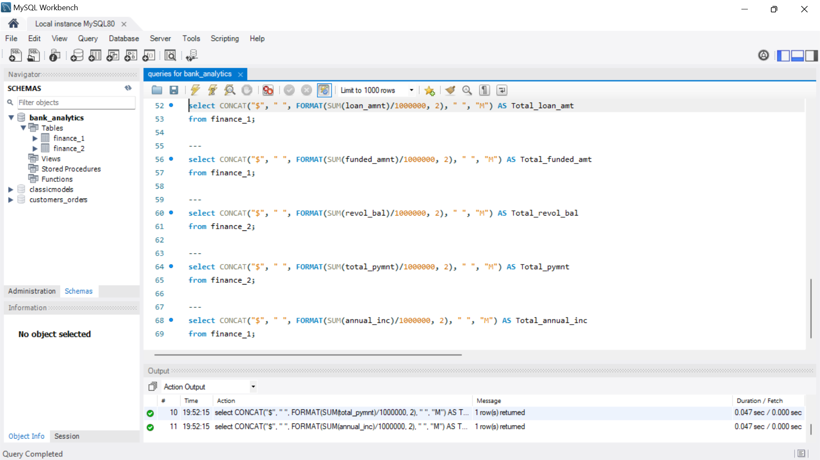
SQL
State wise and month wise loan status
Totals

Slide 16
Challenges Data Inconsistencies and Formatting Differences The two files have inconsistencies in data formats, naming conventions, and data types (e.g., date formats, currency notations, and numerical formatting). Duplicate or Missing Records Duplicate entries or missing records between the files lead to data inaccuracies if not properly managed. Different Data Structures and Columns The sheets may have differing structures, with unique columns in each file or mismatched naming conventions for similar fields (e.g., one file may use "Loan Amount" while the other uses "Principal"). Complex Merging and Joining Criteria Consolidating data require complex joins, particularly if there isn’t a single common identifier for each record (e.g., combining data based on multiple fields like customer ID, account ID, and date).

Slide 17


Conclusion
The insights derived from the data indicate that loan activity is highly influenced by seasonal and regional factors, as well as customer verification and credit grade status. By aligning resources with quarterly demand, focusing on high-potential regions, encouraging verification, and implementing risk management strategies for high-balance customers, the bank can optimize its operations, mitigate risk, and enhance customer satisfaction. Targeted marketing, resource planning, and tailored financial products will help the bank to expand its market presence and strengthen its loan portfolio over time.

Slide 18




Thank you
Presented by
Asumithra. C,
Godlaveeti durga kalyan,
M Yaswanth Reddy,
Rahul pravin Jadhav.

